Slide 1
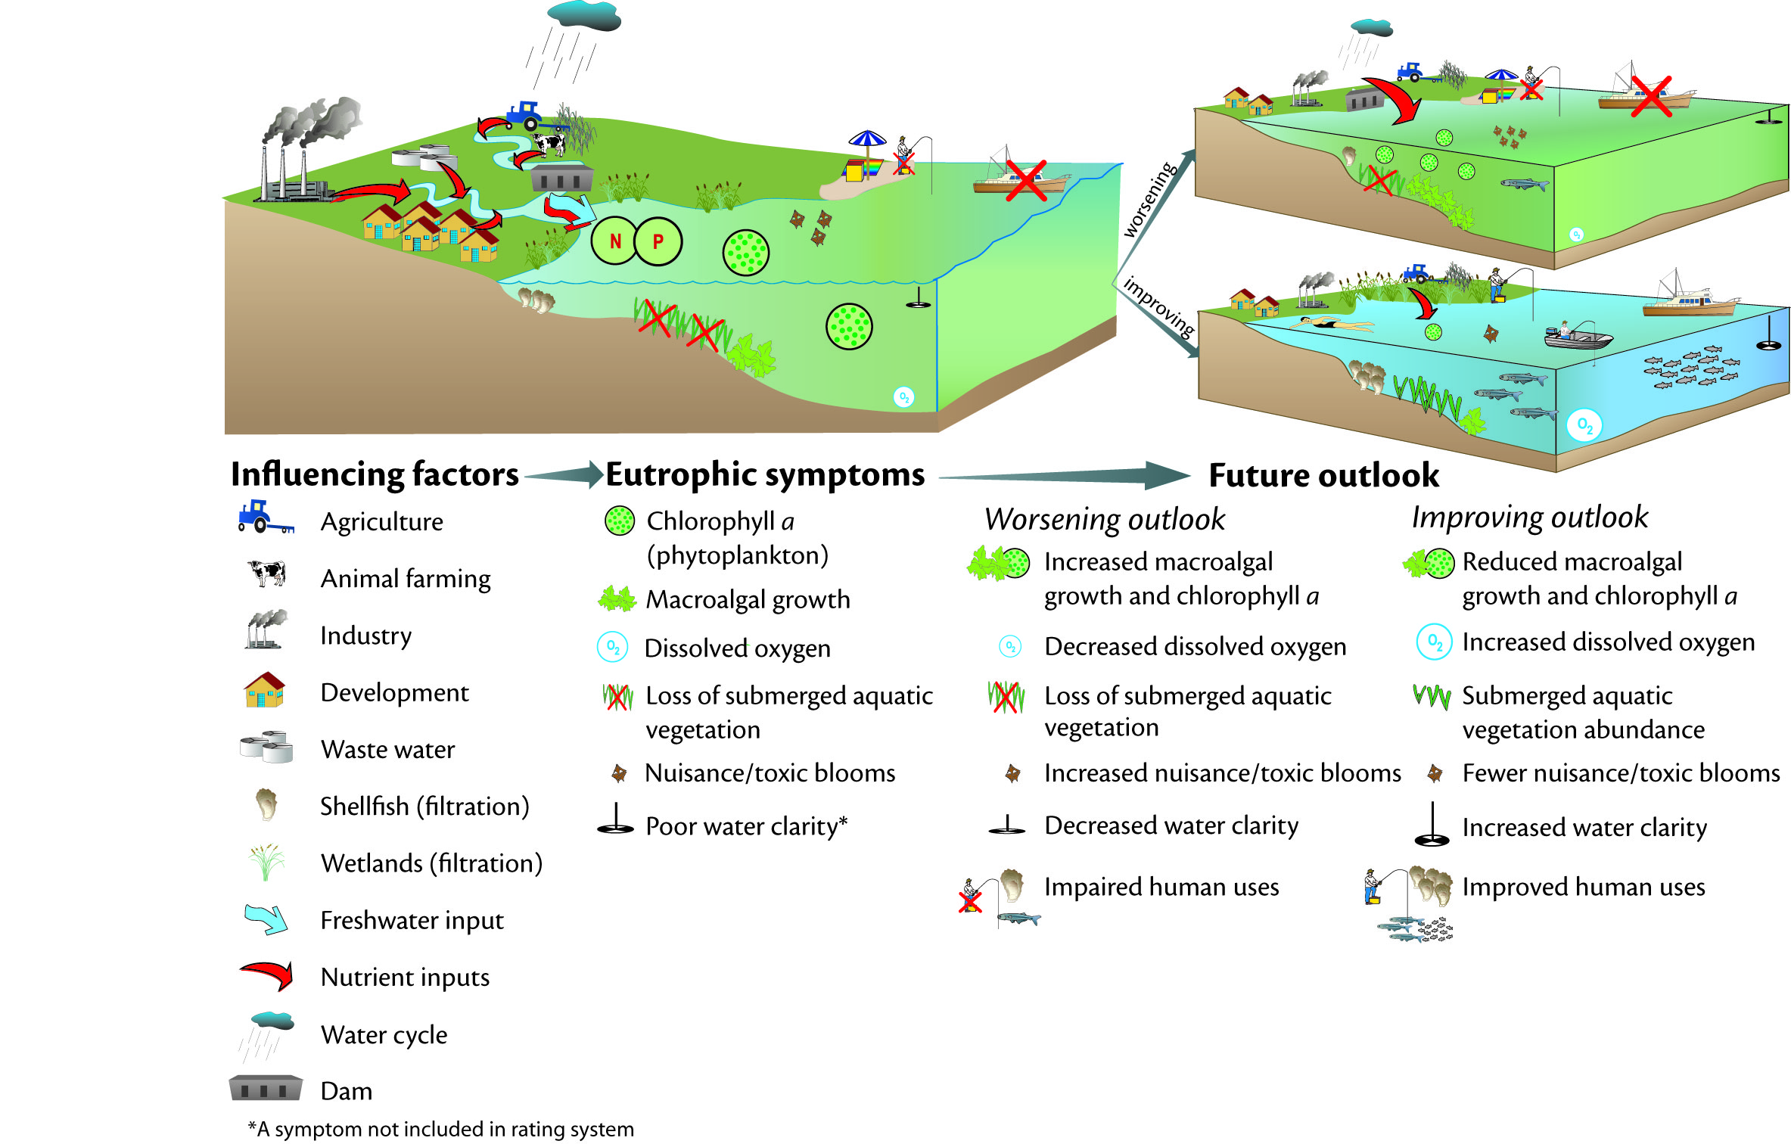
The Eutrophication Process
From: Bricker et al. 2007. National Estuarine Eutrophication Assessment Update
http://www.eutro.us http://www.eutro.org/register

Slide 2
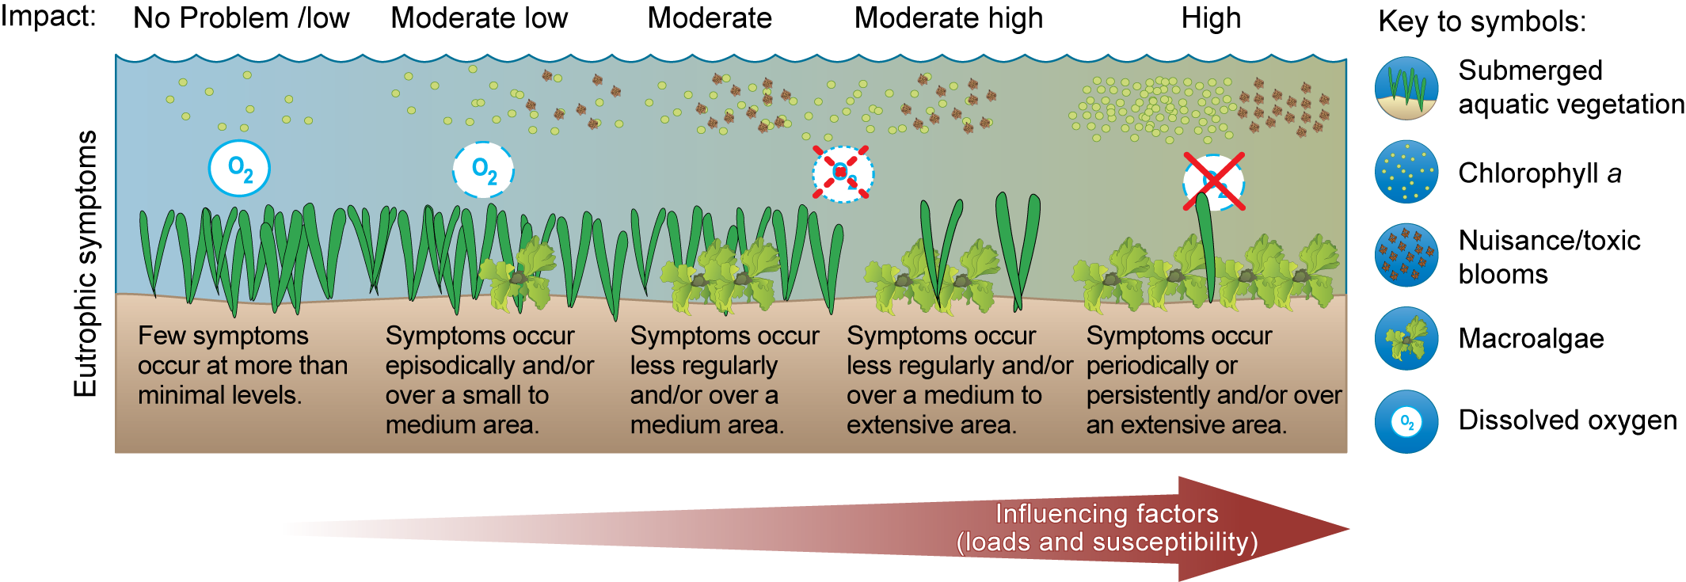
Eutrophication Stages of environmental degradation
From: Bricker et al.2007. National Estuarine Eutrophication Assessment Update
http://www.eutro.us http://www.eutro.org/register

Slide 3
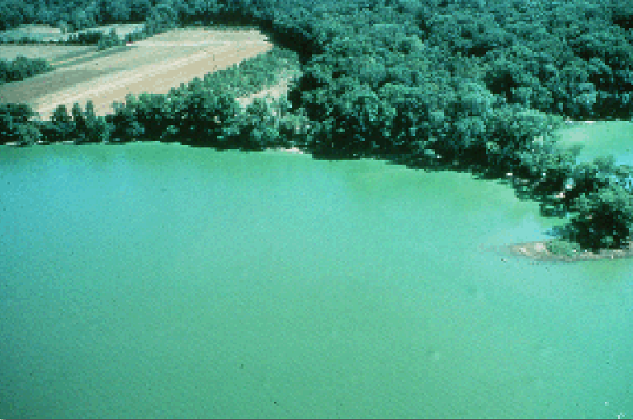
Cyanobacteria bloom – Potomac estuary
Nitzchia bicapitata
This dense bloom of cyanobacteria (blue-green algae) occurred in the Potomac River estuary downstream of Washington, D.C. Photo courtesy of W. Bennett USGS.

Slide 4
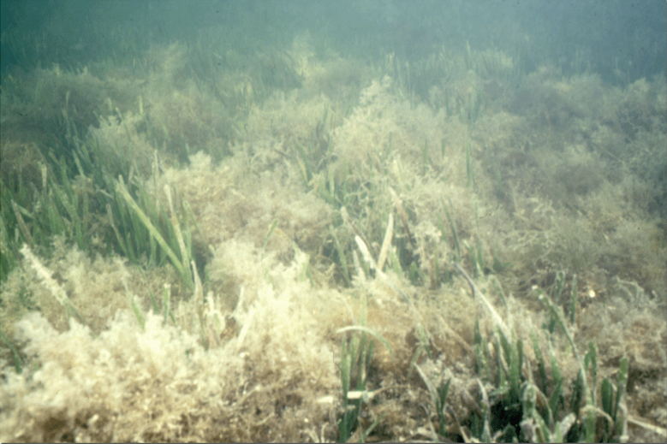
Management relevance – macroalgal bloom, Florida
Nitzchia bicapitata
In Florida Bay, this seaweed bloom smothered seagrasses, leading to disappearance of SAV. Brian Lapointe, Harbor Branch Oceanographic Institute.
Notes:
Thalassia testudinum (turtle grass). Macroalgae, Spyridia? Could be Enteromorpha or other filamentous species

Slide 5
Management relevance
Ulva prolifera in Jiaozhou Bay, NE China, 2008
Chlorophyll a
(mg m⁻³)
These macroalgal blooms have occurred annually for the last five years

Slide 6
ASSETS screening model
A second generation framework for eutrophication assessment.

Slide 7
ASSETS Influencing Factors (Pressure)
Calculate m_{h}, the expected nutrient concentration due to land based sources (i.e. no ocean sources);
Calculate m_{b}, the expected background nutrient concentration due to the ocean (i.e. no land-based sources);
Calculate OHI as the ratio of m_{h}/(m_{h}+m_{b});
Class Thresholds
Low 0 to <0.2
Moderate low 0.2 to <0.4
Moderate 0.4 to < 0.6
Moderate high 0.6 to < 0.8
High >0.8
Equations are based on a simple Vollenweider approach, modified to account for dispersive exchange:
Anthropogenic inputs
Ocean inputs
Estuary
Bricker, S.B., Ferreira, J.G. & Simas, T. - An Integrated Methodology for Assessment of Estuarine Trophic Status. Ecol. Modelling 169: 39-60.

Slide 8
ASSETS – Assessment of State
Eutrophic condition
1
1
MODERATE HIGH
MODERATE HIGH
HIGH
MODERATE
HIGH
MODERATE
Primary symptoms high
Primary symptoms high
High primary and
Primary symptoms high
High primary and
Primary symptoms high
and substantial
and substantial
secondary symptom
but problems with more
secondary symptom
but problems with more
secondary symptoms
symptoms
secondary symptoms
symptoms
High primary
High primary
levels indicate serious
serious secondary
levels indicate serious
serious secondary
becoming more
becoming more
eutrophication
symptoms still not being
eutrophication
symptoms still not being
expressed, indicating
expressed, indicating
problems
expressed
problems
expressed
potentially serious
potentially serious
problems
problems
0.6
0.6
MODERATE LOW
MODERATE LOW
HIGH
Primary symptoms
HIGH
Primary symptoms
Substantial levels of
MODERATE
Substantial levels of
beginning to indicate
MODERATE
beginning to indicate
eutrophic
eutrophic
conditions
Level of expression of
conditions
symptoms
Level of expression of
symptoms
Moderate primary
Moderate primary
possible problems
possible problems
occuring
eutrophic
occuring
with secondary
eutrophic
conditions is
but still very few
conditions is
but still very few
symptoms indicating
substantial
symptoms indicating
secondary symptoms
substantial
secondary symptoms
serious problems
expressed
serious problems
expressed
0.3
0.3
MODERATE HIGH
MODERATE LOW
MODERATE HIGH
MODERATE LOW
High secondary
Moderate secondary
High secondary
LOW
Moderate secondary
LOW
symptoms indicate
symptoms indicate
symptoms indicate
Level of expression of
symptoms indicate
symptoms
Level of expression of
symptoms
Low primary
Low primary
serious problems, but
substantial
serious problems, but
eutrophic
substantial
eutrophic
eutrophic
conditions is
conditions is
low primary indicates
conditions, but low
low primary indicates
minimal
conditions, but low
minimal
other factors may also
primary indicates other
other factors may also
primary indicates other
be involved in causing
factors may be involved
be involved in causing
factors may be involved
in causing the conditions
in causing the conditions
conditions
conditions
0
0
0.3
0.3
0.6
0.6
1
Low secondary
1
Low secondary
Moderate secondary
Moderate secondary
High secondary
High secondary
symptoms
symptoms
symptoms
symptoms
symptoms
symptoms
Combinatorial matrix for primary and secondary symptoms.

Slide 9
ASSETS Future Outlook matrix
1
1
Low
Improve
High
No change
Worsen Low
0.6
0.6
Susceptibility
Improve
Low
No change
Worsen
Low
Moderate
0.3
0.3
High
Improve
Low
No change
Worsen High
in causing the conditions
in causing the conditions
0
0
0.3
0.3
0.6
0.6
1
1
Decrease
No change
Increase
Future nutrient pressures
Takes into account susceptibility and planned management actions.

Slide 10
ASSETS Approach: Pressure - State - Response
Influencing Factors (IF)
Eutrophic Condition (EC)
Future Outlook (FO)
High
Moderate
Moderate High
High
Moderate High
High
Low
Improve
High
No
Change
Worsen
Low
High
Moderate
Susceptibility
Moderate Low
Moderate
Moderate High
Moderate Low
Moderate
Primary Symptoms
Moderate
High
Moderate
Improve
Low
No
Change
Worsen
Low
Moderate
Susceptibility
Low
Low
Moderate Low
Low
Moderate Low
Moderate High
Low
Low
High
Improve Low
No
Change
Worsen
High
Low
Moderate
High
Low
Moderate
High
Decrease
No Change
Increase
Nutrient Pressures
Secondary Symptoms
Future Nutrient Pressures
Susceptibility
dilution & flushing
+
Nutrient Inputs
land based or oceanic
Influencing Factors
Primary Symptoms
Chl and Macroalgae
Average of ratings
Secondary Symptoms
D.O., HABs, SAV change
Worst case
Susceptibility
Nutrient pressure changes
population , management, watershed use (particularly agricultural)
IF + EC + FO = ASSETS
Full accounting of eutrophication symptoms, including time and space
Adapted from: Bricker et al. 2003, Ecological Modelling, 169(1), 39-60
Notes:
Example of one model that deals with direct and indirect effects

Slide 11
ASSETS – Strangford Lough, N. Ireland
ASSETS: HIGH
Indices
Influencing Factors (IF)
ASSETS: 5
Eutrophic Condition (EC)
ASSETS: 5
Future Outlook (FO)
ASSETS: 4
Methods
Susceptibility
Nutrient inputs
Primary
Secondary
Future nutrient pressures
Parameters Rating Expression
Dilution potential High Low
susceptibility
Flushing potential Moderate
Low
Chlorophyll a Moderate
Moderate
Macroalgae Problems
observed
Dissolved Oxygen No problems
Submerged Aquatic Losses
Vegetation observed Low
Nuisance and Toxic No
Blooms
Future nutrient pressures decrease
Index
LOW
LOW
Improve Low
High status system, classified as an SAC under UK law.

Slide 12
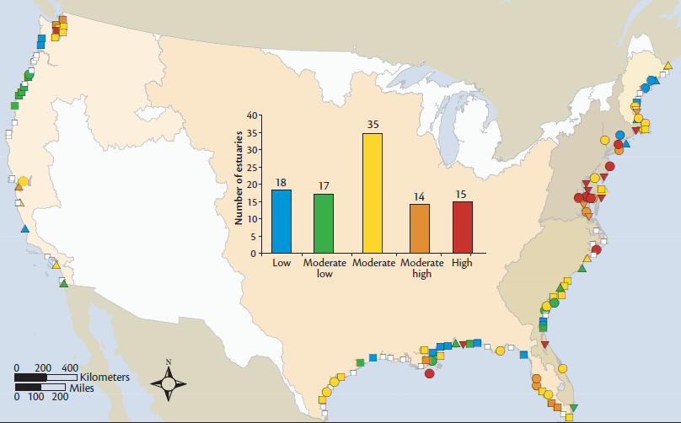
ASSETS multiple site comparisons
http://ian.umces.edu/neea http://www.eutro.us
The most recent assessment shows problems in the NEA and Gulf of Mexico

Slide 13
ASSETS Pressure-State-Response
压力 状态 反馈 ASSETS结果
Influencing Factors
Eutrophic Condition
Future Outlook
ASSETS
Top-down control shellfish aquaculture
贝类养殖的下行控制效应
Huang He
Sanggou
Jiaozhou
Chiangjiang
Huangdun
Sanmen
Xiamen
Daya
Zhujiang
High
Moderate High
Moderate
Moderate Low
Low or No Problem
Unknown
Worsen High
Worsen Low
No Change
Improve Low
Improve High
Unknown
Bad
Poor
Moderate
Good
High
Unknown or Not Applicable
(WFD)

